Slide 1

Python & Data Science Training Project 3 – Mortgage Origination Analysis

Slide 2

Purpose of the Study
This project will compare the quality of mortgage loans originated in Q1 2008 and Q1 2018.
Origination
Q 1 2008: Before the financial meltdown in Q3 2008, US had a very lax rule for approving a loan.
- No income verification was needed.
- Borrowers were allowed to pay for interest for some years.
- Borrowers enjoyed teaser rate (low rate) in first 3-5 years.
- Borrowers with very low credit scores can also buy houses, aka subprime loans (次贷）
How could the above have happened?
It was believed that the house price would go up quickly. Even if you could not make monthly payment, you can always sell the house at a much higher price. There is very little risk to the bank (lenders) and the customers (borrowers).
After 2008, the US government enforced very restrictive rules(such as for LTV and DTI) regarding loan approval.

Slide 3
Videos on financial meltdown in 2008
https://www.youtube.com/watch?v=iiWIVBvDymI
https://www.youtube.com/watch?v=GPOv72Awo68
https://www.youtube.com/watch?v=RrFSO62p0jk

Slide 4
Link to the file for the project
- I suggest you go through the steps specified in Data Source and download the data from Fannie Mae website.
- If your computer is not powerful to run Part 0 of the Jupyter Notebook, you can download the zipped data by using the following link:
https://1drv.ms/u/s!Amfo1lixPzv-j2wgZbQRbmS4CFji?e=TJM6tG
There are 10 files after you have unzipped it.
For using the unzipped data, you can start with Part 1 of Jupyter Notebook.

Slide 5
We will compare loan quality in the following aspects
FICO score
Loan Purpose
Purchase (less sensitive to interest changes. 刚需）
relocation to a new place
Getting married
Rate refinance (very sensitive to interest rate)
When interest rate drops, a refinance can low down mortgage payment.
Cash out refinance (very sensitive to interest rate)
Example: A house of $1mm with $600 in unpaid principal (loan amount).
The borrower can get $50K from the bank to finance remodeling.
His/her new unpaid principal is now $650K.
Interest only loans
LTV (loan-to-value ratio)
LTV=loan amount / house selling value
DTI (debt-to-income ratio)
DTI=debt payment /Income

Slide 6
Python & DS Skills Learned in this Project
How to extract data from Fannie Mae website.
Use pandas and numpy to do the following:
Reading in csv or Excel data to python.
Merging data.
Correlation between variables/columns.
Use matplotlib and seaborn to visualize data and findings.
Comparison of performance of two groups of accounts
Use of logistic regression to extract insights/knowledge
Segmentation

Slide 7
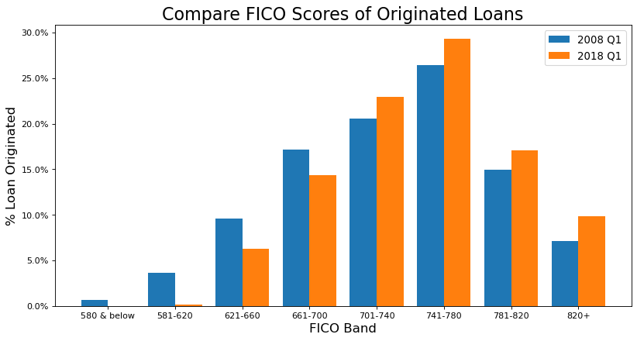
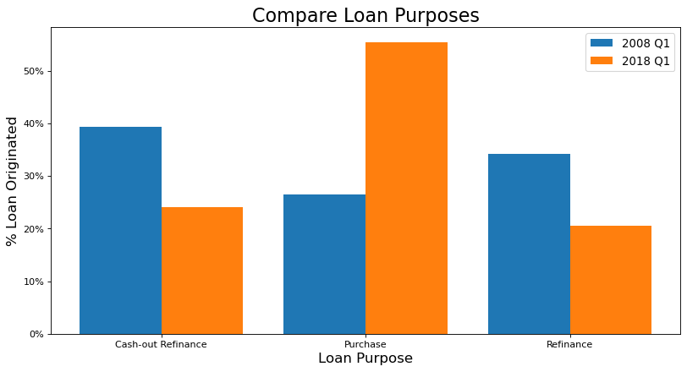
Example of visualization - Loan Quality

Slide 8
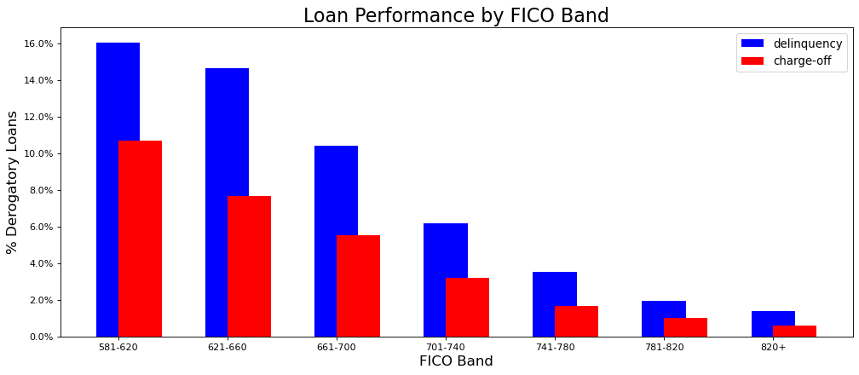
Example of visualization FICO and loan performance

Slide 9
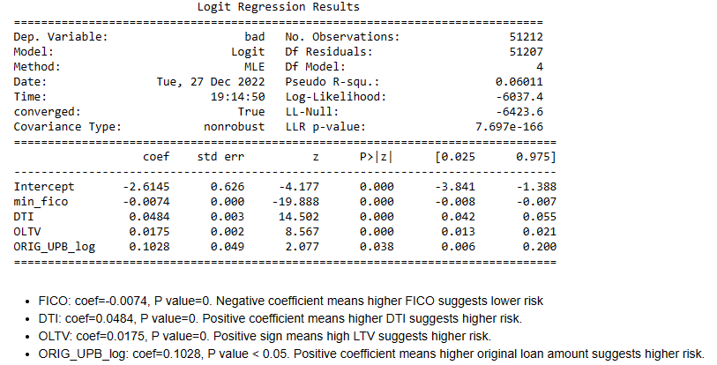
Regression analysis - Logistic regression (outcome coded not a continuous number, but in 0 or 1)

